Slide 1

United International University
Project: Trash Management System
Team : Fusion-0.2
Team Members
Abdullah Al Mofael (011181267)
S.M Sayeed Hossain(011191114)
Md. Maruf Raihan (011201196)
Submitted To
Md Fakhruddin Gazzali Fahim
Lecturer, United International University.

Slide 2
Proposal
Our project is about Trash Management System.
Why Trash management system?
The proposed idea for the Trash management system is a completely automated system that enables users and Trash management officials to monitor the amount of waste generated from each household and track the vehicles that transport the waste from each locality to the destination.

Slide 3
Features
Home
About
Login/Registration
Services
Daily Updates
Complaint
Area Information

Slide 4
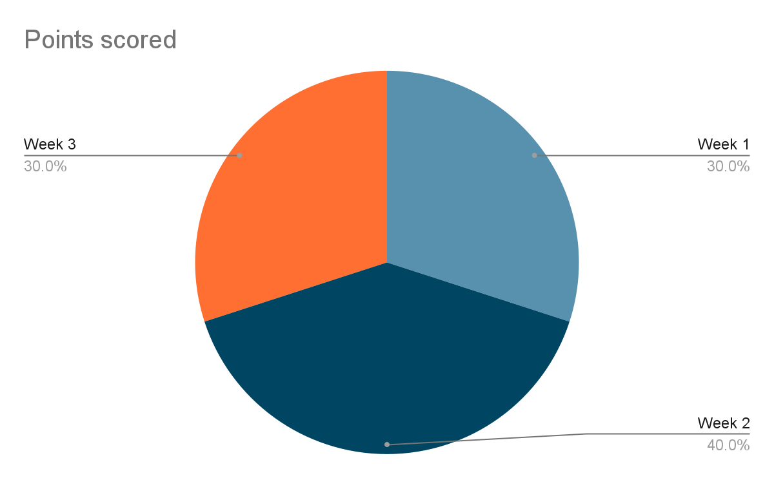
Weekly Updates
Week 1:
Designing website, adding admin panel,staff monitor panel ( Front-end & Back-end)
Week 2:
MySQL, PHP (Insert,Update,Delete areas), Services, complain. (Front-end & Back-end)
Week 3:
Overall reviews, finding bug and recover.

Slide 5
Task Distribution
Front-end: (HTML,CSS,Bootstrap v - 5.1.3)
S.M Syeed Hossain (011 191 114)
Md. Maruf Raihan (011 201 196)
Back-end:
Abdullah Al Mofael (011 181 267)
Md. Maruf Raihan (011 201 196)

Slide 6
Why our project is unique???
Our project (Trash Management System) helps users and Trash management officials to monitor the amount of waste generated from each household and track the vehicles location that is used to transport the trash from each locality to destination.
The concept of green-points can be implemented that would encourage the involvement of the residents or the end users making the idea successful and helping to achieve joined efforts for the trash management and hence fulfilling the idea of green environment.

Slide 7
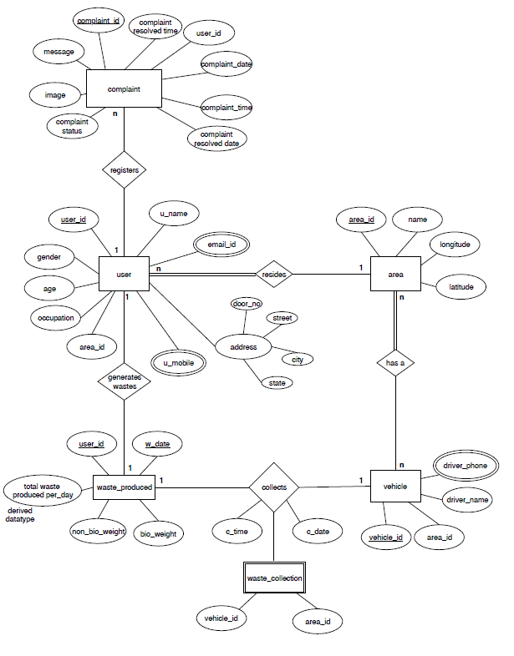
E-R Diagram

Slide 8

Thank You

